Slide 1
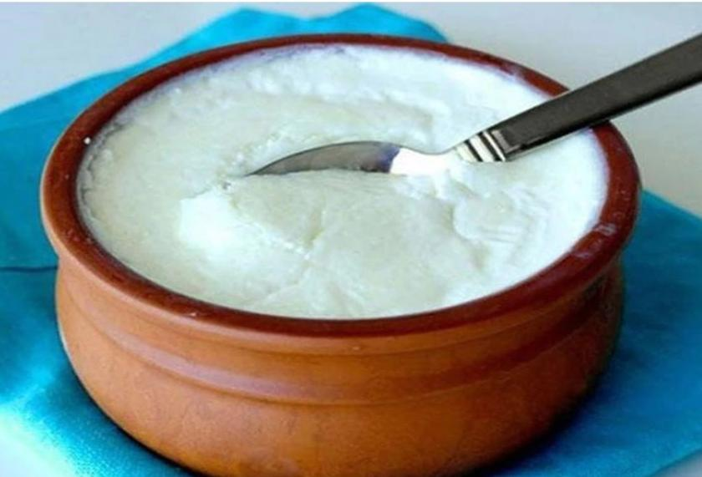
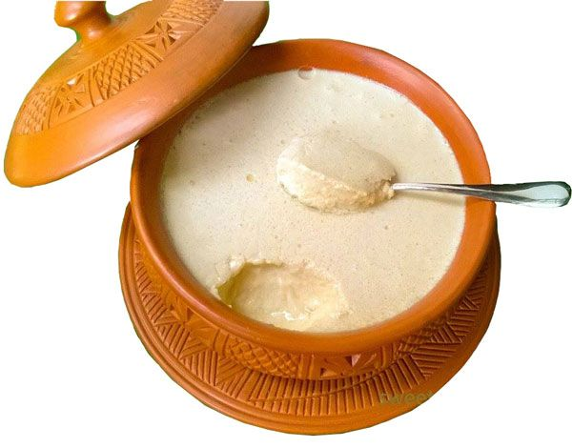
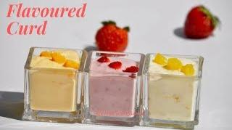
PROJECT ON ENTREPRENEURSHIP
DEVELOPMENT OF CURD PLANT
GUIDED BY:-
PROJECTED BY:-
APURBA GIRI¹ &
AYAN MONDAL²
HEAD OF ASSISTANT PROFESSOR ¹
ASSISTANT PROFESSOR ²
(DEPT. OF NUTRITION)
Mugberia Gangadhar Mahavidyalaya
SUBHECHHA MAITY
ROLL- 2232
DEPARTMENT OF NUTRITION
B.Voc Food Processing 6th semester
Mugberia Gangadhar Mahavidyalaya

Slide 3
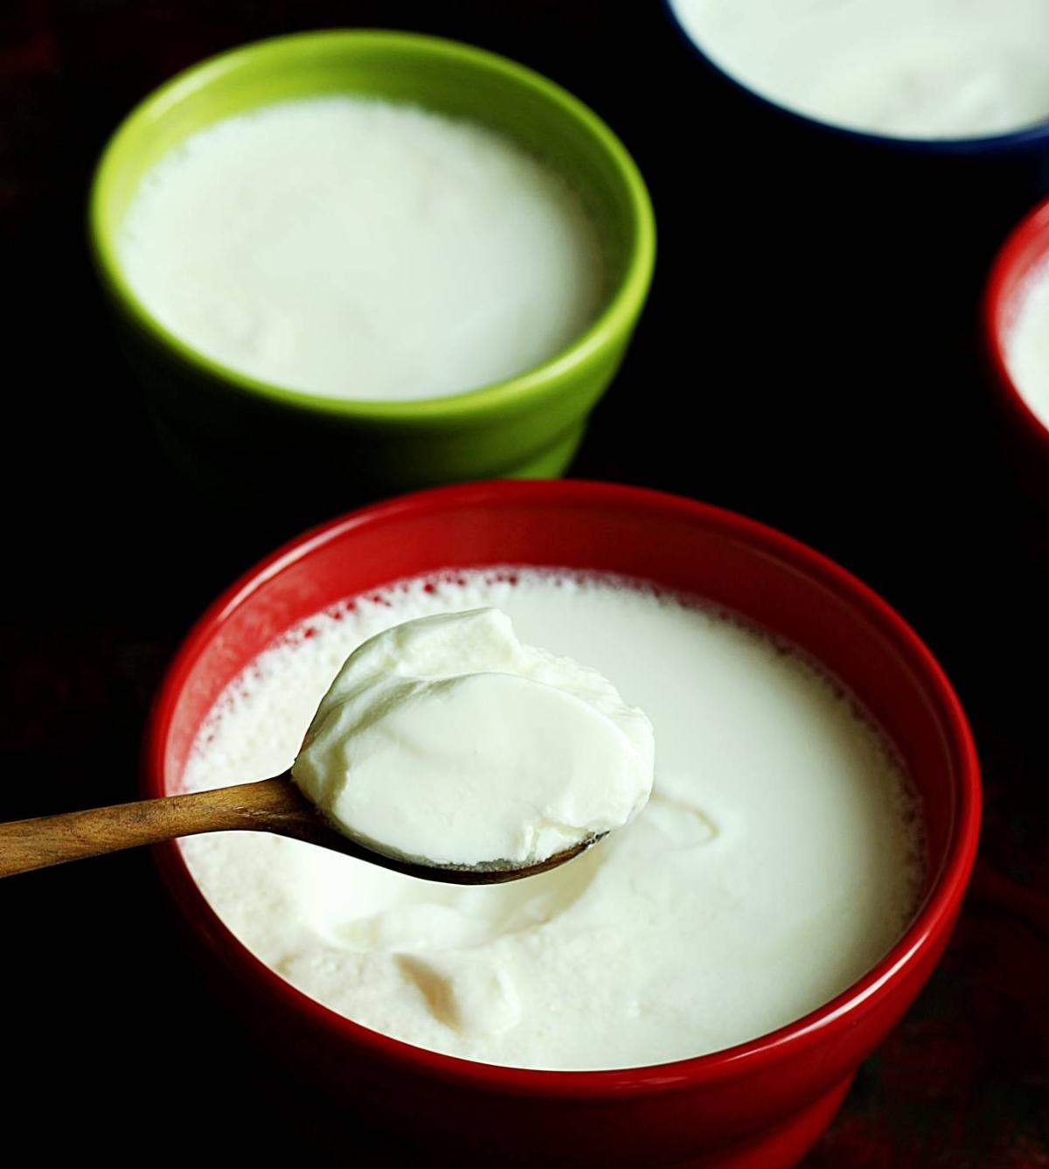
Introduction
Curd, also known as yogurt, is a popular dairy product that has been consumed for centuries. It is a rich source of nutrients, including calcium, protein, and probiotics, which are beneficial for gut health. With the growing demand for healthy and nutritious food options, the curd business has become a lucrative opportunity for entrepreneurs.

Slide 4
Market survey
To conduct a market survey for a curd business, start by defining your target market and identifying your competition. Then, ask potential and current customers about their preferences, satisfaction, and opinions on marketing messages. Analyze the results to develop a marketing strategy and make informed decisions. A market survey can provide valuable insights into the needs and preferences of your target market, identify opportunities for growth and improvement, and guide your business decisions.

Slide 5
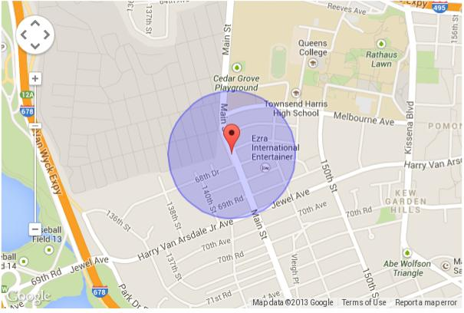
Location choose
In order to select the location, you must consider the area where you want to open the curd industry.
You should go to the city, suburban, and rural area but make sure you should choose the pollution free area. You should also make a rough plan and estimation of your spending. Because card industry requires so much money and investment in order to make the building.
You need more money to buy bricks, cement, and some other things which are necessary to make the building.

Slide 6
Business research
Demand
Supply
Price
Quality
Quantity

Slide 7
Investment
CAPITAL 45-50 LAKHS

Slide 8
Licence
Business entity
Trade license
GST registration (Goods & Service Tax)
BIS certificate
BIS registration
FSSAI( Food Safety and Standards Authority of India)
No objection certificate

Slide 9
Manpower
Guard- 2
Weighting area- 1
Lab- 2
Processing- 3
Packaging- 2
Store- 2
Boiler section- 2
Chilling section- 2
Washing-2
ETP- 1
Data documentation- 1
Shift incharage- 2
Electrician- 2
Overall management- 1
25-30 Labours

Slide 10
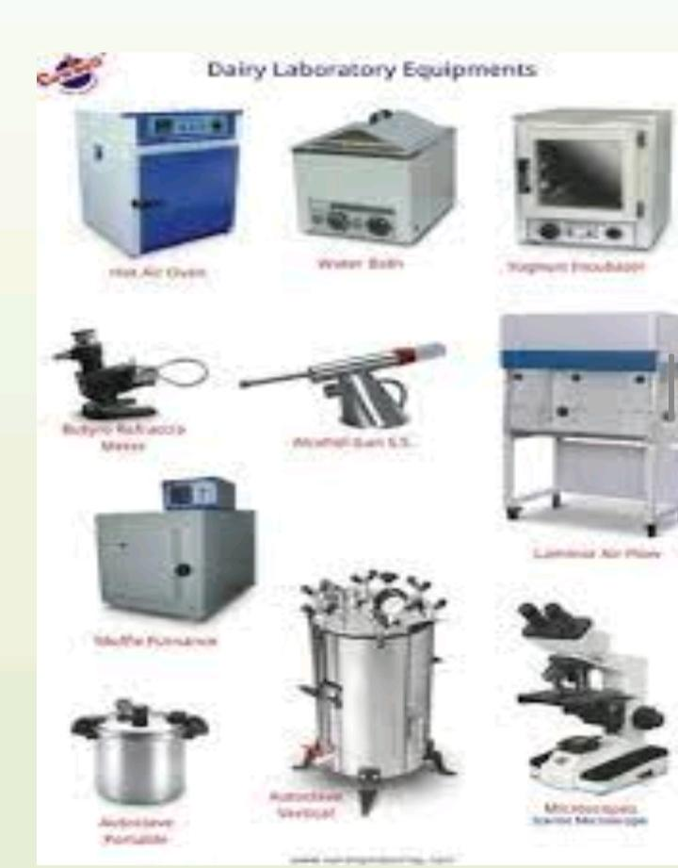
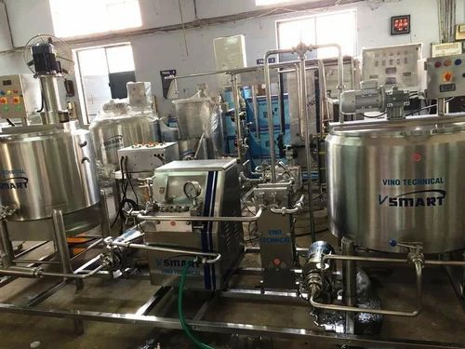
Machinery
Milk storage tank
Pasteurizer
Pasteurizer holding tube
Thermometer
Lactometer
Gerber centrifuge
Refrigerator
weight machine
Water bath
Hot air oven
Packaging machine

Slide 11
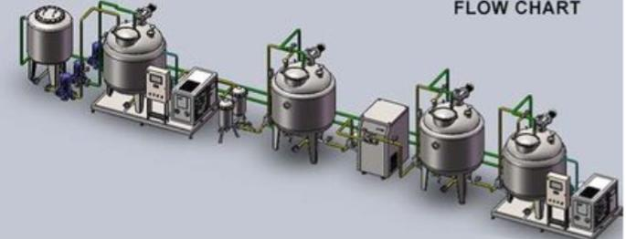
Flow chart
Receiving of milk
Preheating
(35-40°C)
Filtration/Clarification
Standardization
( Fat: 0-5%, SNF: 11-13)
Cooling to 30°C
Heat treatment
( 90°C/10min)
Preheating ( 60°C )
Homogenization
Packaging
Incubation
(30°-37°C/6-8hr)
Curd
Addition of starter cultures (1-1.5%)
Cooling and storage<5°C

Slide 12
Laboratory test
Fat test
SNF test
Acidity test
Alcohol test

Slide 13
Production cost of Per 1 Kg curd
Component of cost | Cost( RS./Kg)
Raw material | 40
Labour | 5
Electricity | 10
Water | 2
Others | 3
Total cost | 60
Total cost approx 60 rupees per kg
Selling price 100 rupees
Total profit:- 40

Slide 14
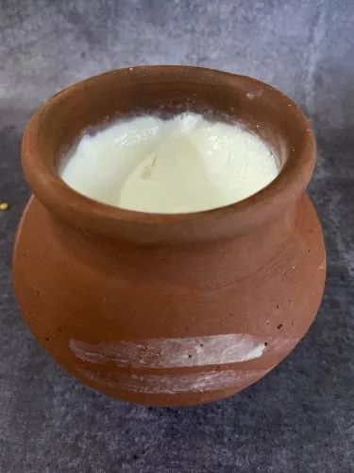
Products details
250 gm
500 gm
1 Kg

Slide 15
Layout

Slide 16
Market strategy
Local market announcement
Advertising
Sales promotion
Special discount
Direct marketing

Slide 17
Target customer
Wholesalers
Sweet shops
Hotels and restaurants
Marriage and functions

